Slide 1
Chapter 7 Clock-Domain Crossing (CDC)
Dr. Ahmed Abou-Auf
Fall 2019

Slide 2
Why Multiple Clocks?
Most designs requires multiple clock sources
E.g., external communication link
Bigger designs perform better with multiple clocks
Clock skew increases with the # FFs in a system.
Bigger circuits has higher number of logic levels and might be scarce in routing resources
Subsystems might be better run at slower clocks to meet timing requirements.
Interfaces with external devices require multiple clocks
E.g., as sysetm w/ 16-bit 20 MHz processor, 1-bit 100 MHz serial interface, 1 MHz I/O controller
Slower Clocks consumes less power
Dynamic power proportional to switching frequency

Slide 3
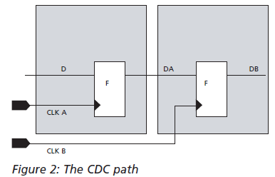
What is a Clock Domain?
Definition
A clock domain is defined as that part of the design driven by either a single clock or multiple clocks that have constant phase relationships.
CLK A = 100 MHz and CLK B 100 MHz but inverted are in the same clock domain
CLK A = 100 MHz and CLK B 50 MHz are in the same clock domain
Conversely, domains that have clocks with variable phase and time relationships are considered different clock domains and are considered (asynchronous)
CLK A = 100 MHz and CLK B 35 MHz are in different clock domains
CLK A = 100 MHz and CLK B 100 MHz but variable phase different in different clock domains

Slide 4
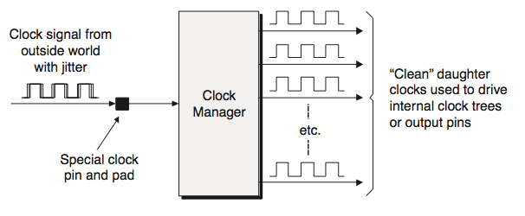
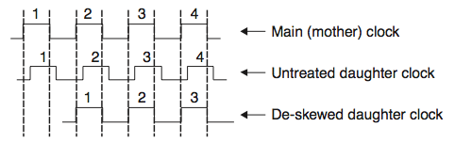
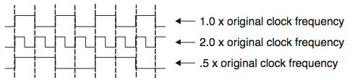
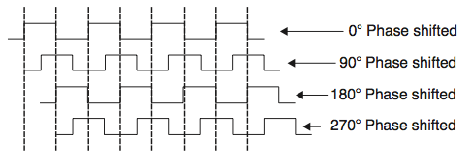
Clock Managers—Phased Locked Loop (PLL)

Slide 5
Timing of a D FF
d
q
clk
Clock-to-q delay
Is the time from clock edge to stable output of the flip flop
Constraint window
Setup time: time data has to be stable before the edge
hold time: time data has to be stable after the edge

Slide 6
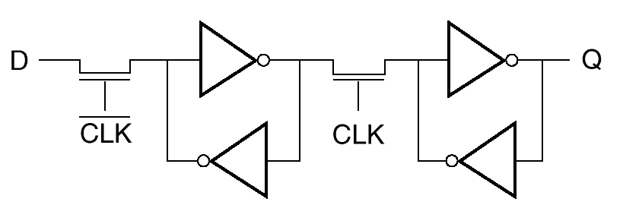
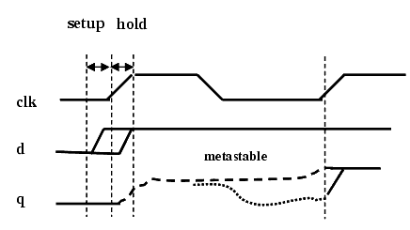
Metastability in Flip Flops
v_{in}
v_{o}
master
slave

Slide 7
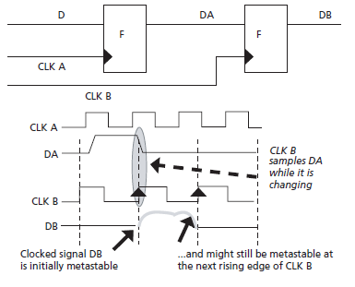
Metastability due to Clock-Domain Crossing
Data signals crossing clock domains are considered asynchronous to destination registers and may result in violation of setup and hold time constraints and consequently might result in metastability.

Slide 8
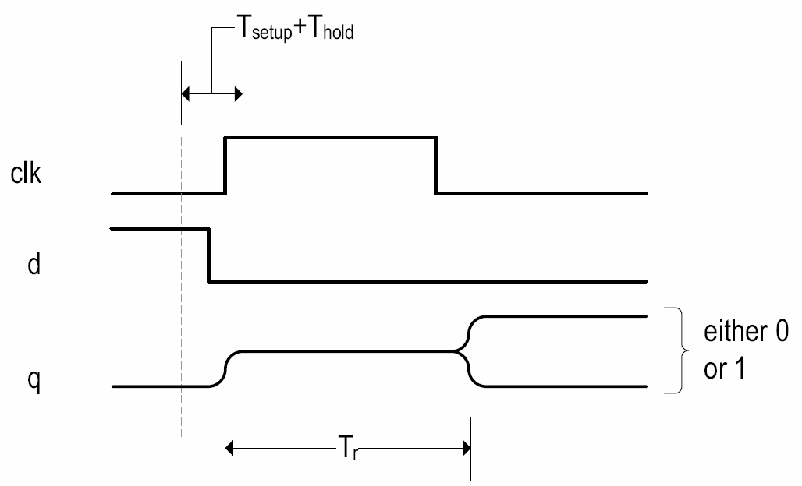
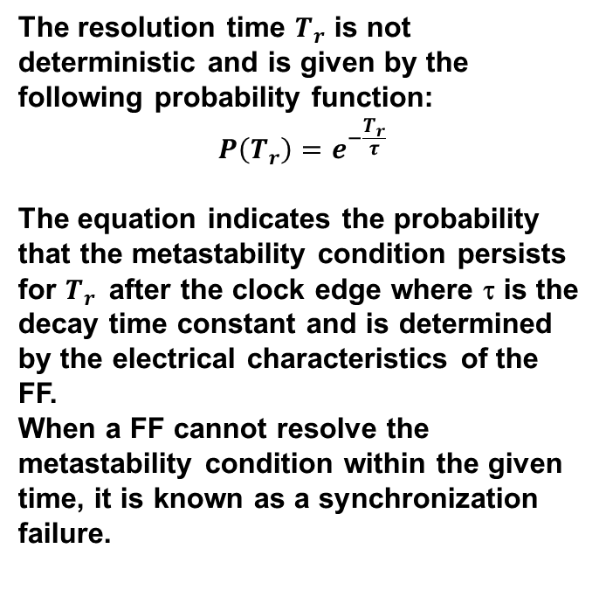
Synchronization Failure
The resolution time $T_{r}$ is not deterministic and is given by the following probability function:
$$P\left(T_{r}\right)=e^{−\frac{T_{r}}{τ}}$$
The equation indicates the probability that the metastability condition persists for $T_{r}$after the clock edge where τ is the decay time constant and is determined by the electrical characteristics of the FF.
When a FF cannot resolve the metastability condition within the given time, it is known as a synchronization failure.

Slide 9
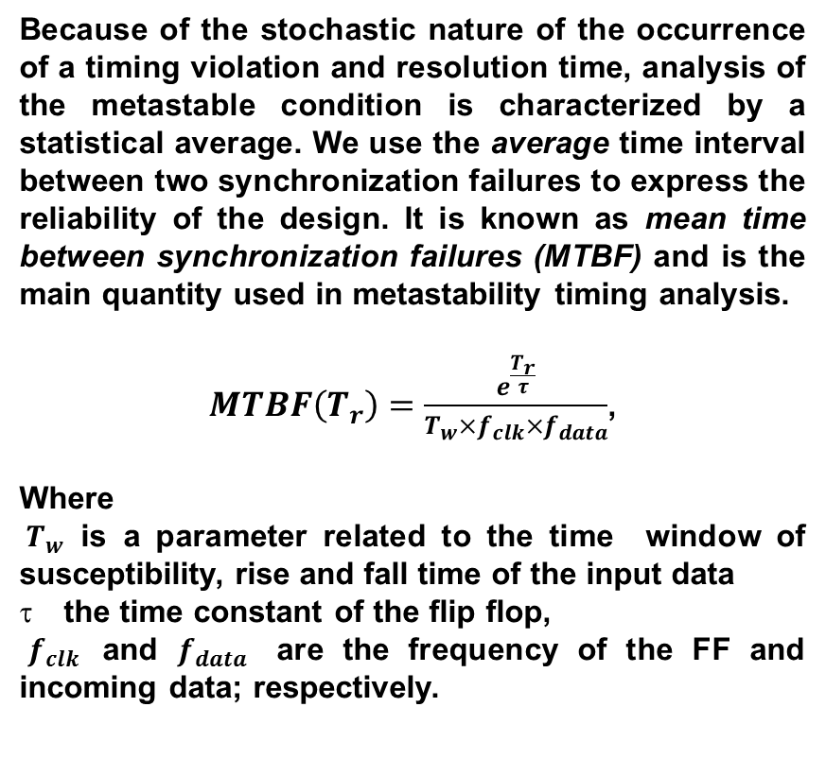
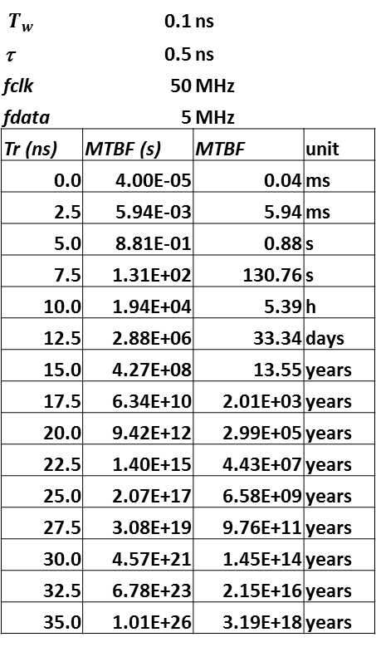
Mean Time Between Failure (MTBF)
Because of the stochastic nature of the occurrence of a timing violation and resolution time, analysis of the metastable condition is characterized by a statistical average. We use the average time interval between two synchronization failures to express the reliability of the design. It is known as mean time between synchronization failures (MTBF) and is the main quantity used in metastability timing analysis.
$MTBF\left(T_{r}\right)=\frac{e^{\frac{T_{r}}{τ}}}{T_{w}×f_{clk}×f_{data}}$,
Where
${ T}_{w}$ is a parameter related to the time window of susceptibility, rise and fall time of the input data
the time constant of the flip flop,
$f_{clk}$ and $f_{data}$ are the frequency of the FF and incoming data; respectively.
${ T}_{w}$ | 0.1 | ns
τ | 0.5 | ns
fclk | 50 | MHz
fdata | 5 | MHz
Tr (ns) | MTBF (s) | MTBF | unit
0.0 | 4.00E-05 | 0.04 | ms
2.5 | 5.94E-03 | 5.94 | ms
5.0 | 8.81E-01 | 0.88 | s
7.5 | 1.31E+02 | 130.76 | s
10.0 | 1.94E+04 | 5.39 | h
12.5 | 2.88E+06 | 33.34 | days
15.0 | 4.27E+08 | 13.55 | years
17.5 | 6.34E+10 | 2.01E+03 | years
20.0 | 9.42E+12 | 2.99E+05 | years
22.5 | 1.40E+15 | 4.43E+07 | years
25.0 | 2.07E+17 | 6.58E+09 | years
27.5 | 3.08E+19 | 9.76E+11 | years
30.0 | 4.57E+21 | 1.45E+14 | years
32.5 | 6.78E+23 | 2.15E+16 | years
35.0 | 1.01E+26 | 3.19E+18 | years

Slide 10





CDC Solution Basics: Synchronizers
With CDC, metastability cannot be avoided but it can be tolerated by making the system more reliable and increasing the MTBF of the receiving flip flop before using its output
Low MTBF
Logic
Tx
Rx
Logic
clkTx
Clock domain Tx
clkRx
Clock domain Rx
Low MTBF
High MTBF
Logic
Tx
Rx
Logic
clkTx
Clock domain Tx
clkRx
Clock domain Rx
2-FF Synchronizer

Slide 11
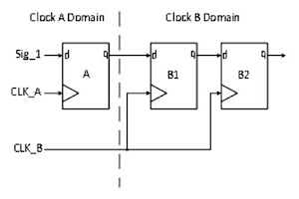
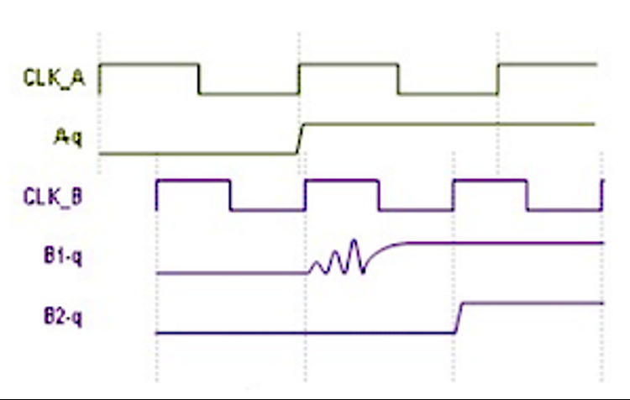
Conventional Two Flip-flop Synchronizer
As shown in Figure 1 and Figure 2, flip flop A and B1 are operating in asynchronous clock domain. There is probability that while sampling the input B1-d by flip flop B1 in CLK_B clock domain, output B1-q may go into metastable state. But during the one clock cycle period of CLK_B clock, output B1-q may settle to some stable value. Output of flop B2 can go to metastable if B1 does not settle to stable value during one clock cycle, but probability for B2 to be metastable for a complete destination clock cycle is very close to zero.
A greater number of flop stages may be used if frequency is too high as it will help in reducing the probability of synchronizer output to remain in metastable state.
Figure 1
Figure 2

Slide 12
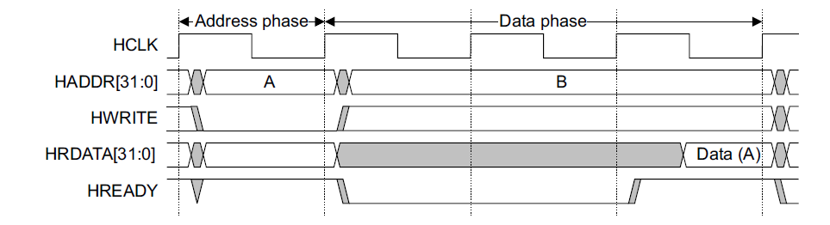
Synchronization Data Buses Crossing Clock Domains
Challenge
One of the challenges in designing a multi-clock based system is to enable correct transfer of data buses from one clock domain to another.
The difficulty arises, as individual bits of a data bus can change randomly while changing clock boundaries.

Slide 13
Synchronization Data Buses Crossing Clock Domains
Solutions
Using MUX based synchronizers.
Using Handshake signals.
Using asynchronous FIFOs (First In First Out memories) to store data with one clock domain and to retrieve data with another clock domain.
Use asynchronous dual port memory

Slide 14
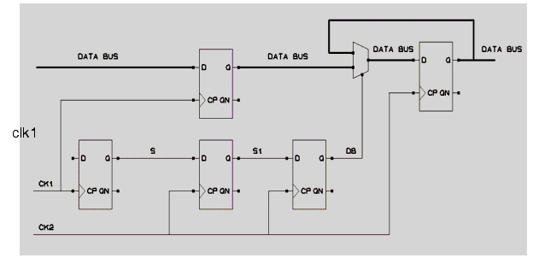
Passing Data through MUX Synchronizer
In a MUX synchronizer, the control path is usually FF-synchronized while the synced-in control signal is used to synchronize the data paths.

Slide 15
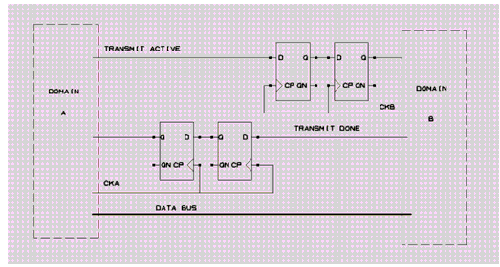
Handshaking Data between Clock Domains
Data can be passed between clock domains using a set of handshake control signals, depending on the application.
The biggest disadvantage in using handshaking is the latency required to pass and recognize all of the handshaking signals for each data word that is transferred.

Slide 16
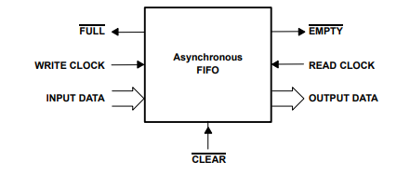
Passing Data between Clock Domains Using FIFO
One of the most popular method of passing data between clock domains is the use an asynchronous FIFO.
One port is controlled by the sender, which puts data into the memory as fast as one data word (or one data bit for serial applications) per write clock. The other port is controlled by the receiver, which pulls data out of memory; one data word per read clock.

Slide 17
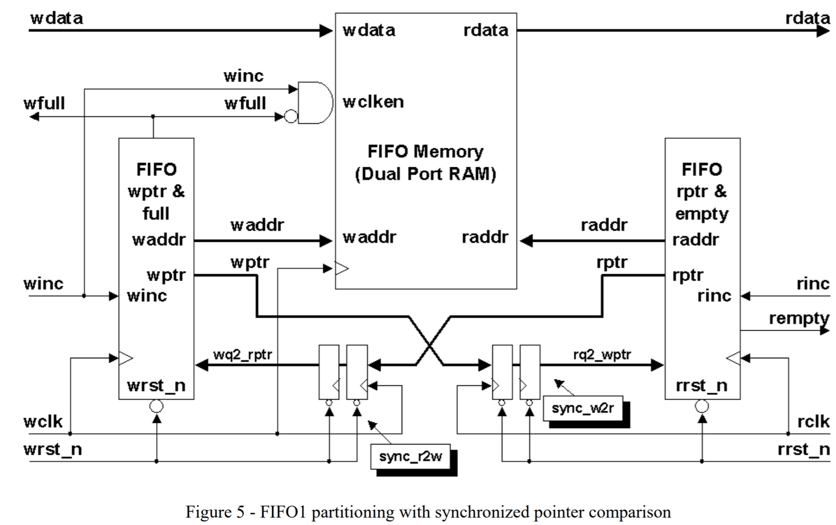
Passing Data between Clock Domains Using FIFO
Two control signals are used to indicate if the FIFO is empty, full, or partially full. Two additional control signals are frequently used to indicate if the FIFO is almost full or almost empty. In theory, placing data into a shared memory with one clock and removing the data from the shared memory with another clock seems like an easy and ideal solution to passing data between clock domains.

Slide 18
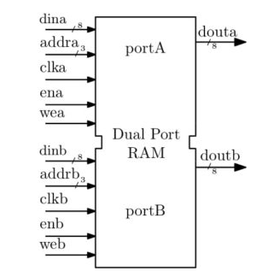
Passing Data between Clock Domains Using DPR
Dual Port Memory (DPR) uses the same memory array.
DPR uses two separate ports to access the array
The two ports can be on separate clock domains
Collision is defined is simultaneous access of the same memory location. Collision can result in corrupted data during read or write
Collision-avoidance techniques should be employed to avoid data corruption

